Slide 1
Virginia State Capitol
July 25, 2017

Slide 2
The Virginia State Capitol in Richmond Virginia has been recently revamped with an extensive below grade visitor center and updated facilities in the historic wing.
The choice to go underground preserved the historic nature of the early footprint designed by Thomas Jefferson. The historic wing of his design was completed in 1792 and two extension wings were completed in 1904.
The new underground extension provided much needed space to inform, engage and provide hospitality to visitors from all over the world. In addition, multi-purpose rooms provide more flexibility to accommodate legislative work.

Slide 3
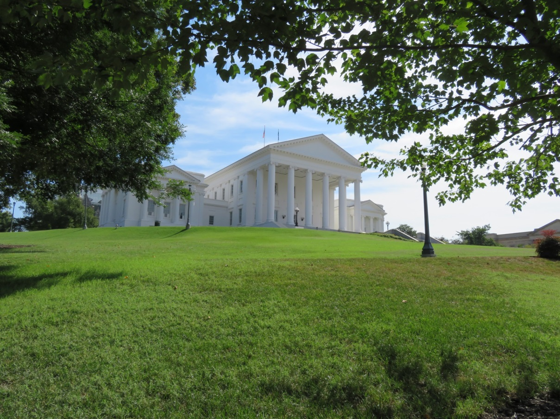
The Virginia Capitol, planned by Thomas Jefferson, was the first Roman classical temple style capitol. Construction began in 1785 and was the first statehouse constructed after the Revolution. This massive South portico has been described as a “frontispiece” to all Virginia.

Slide 4
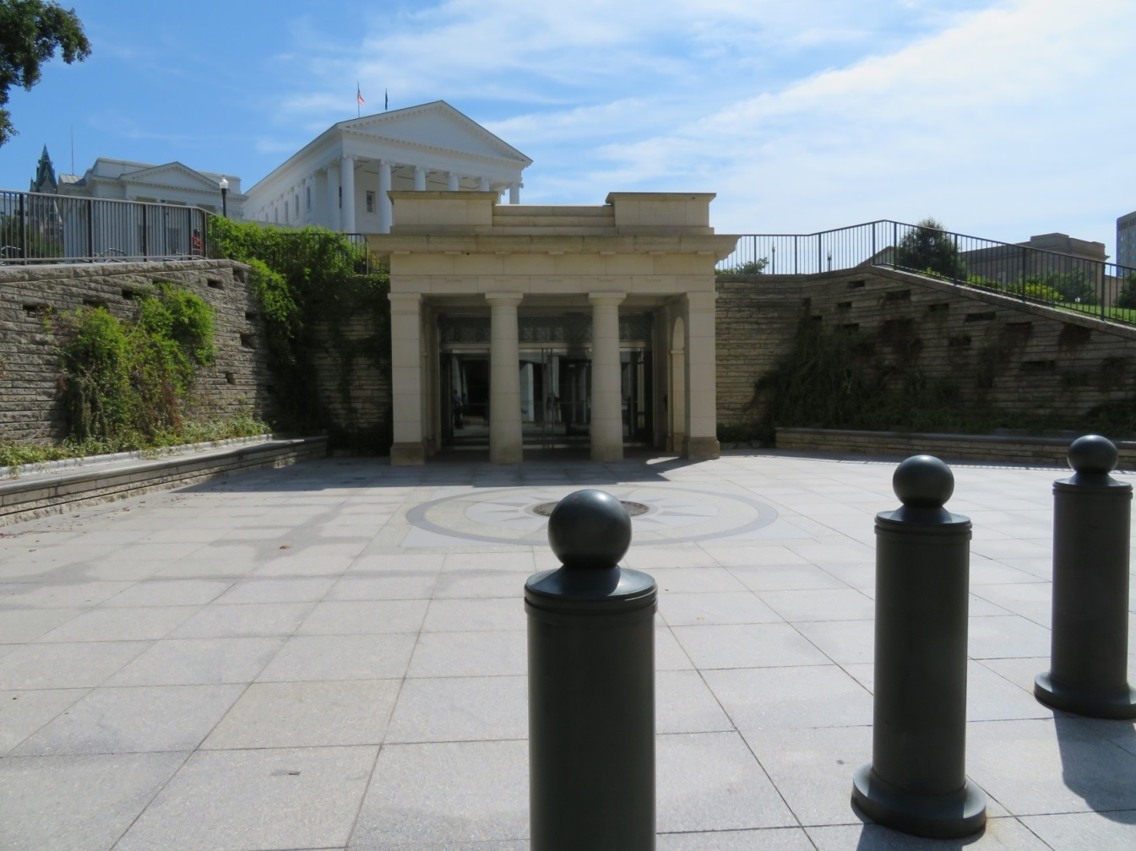
The new underground visitor center entrance is placed so that all who approach the building see the grand view of the South Portico. The entrance is positioned near a busy street so that it is visible to pedestrians and drivers.

Slide 5
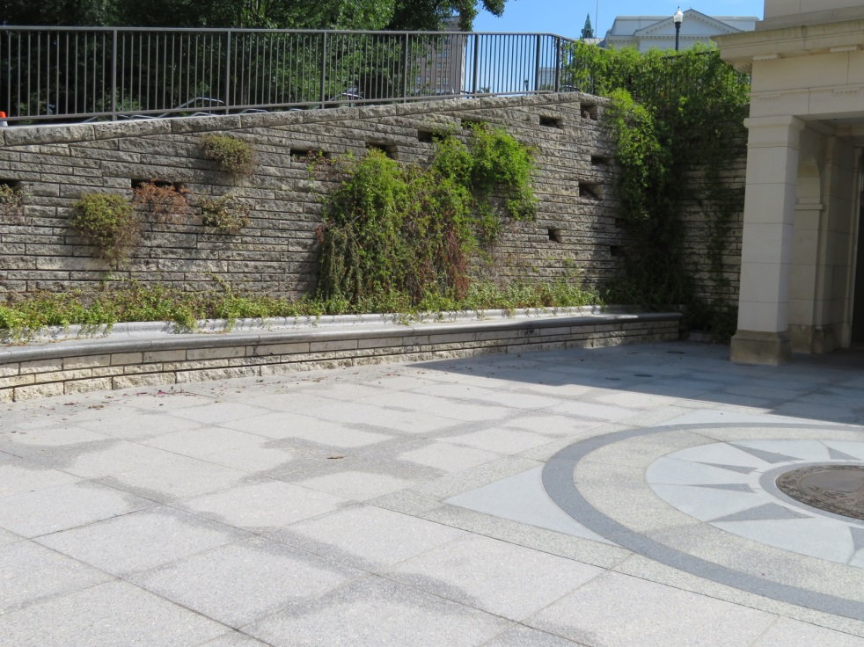
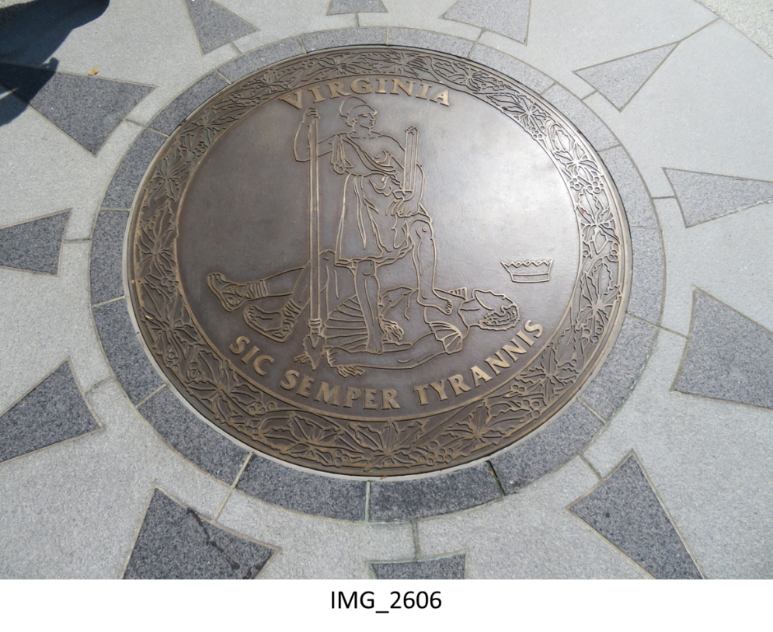
Visitor center entrance details.

Slide 6
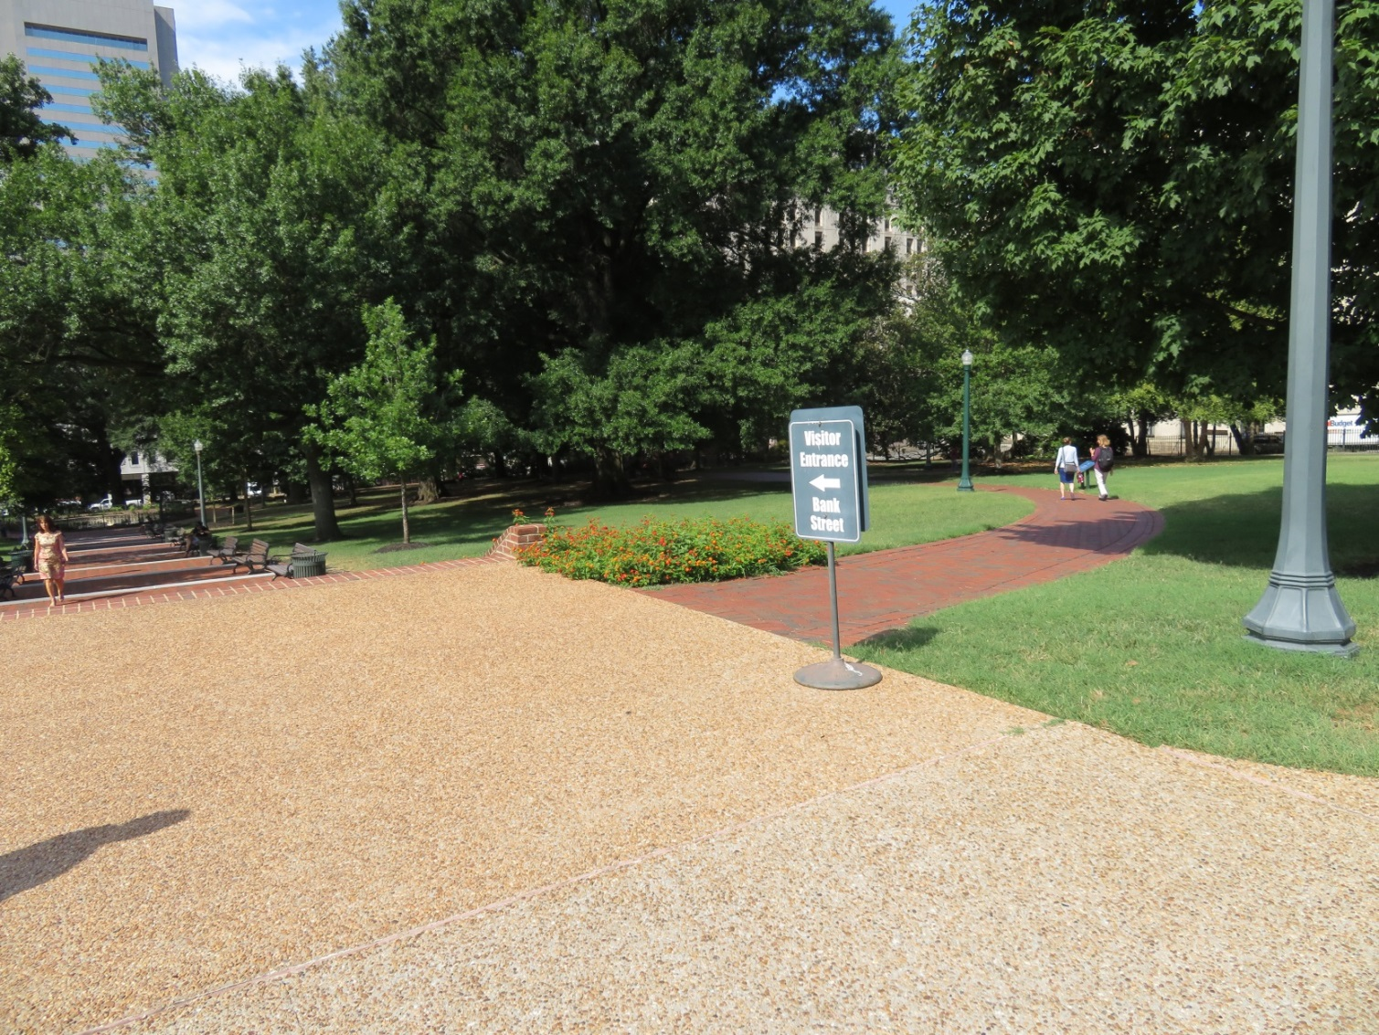
All walkways on Capitol grounds have signage leading visitors to the visitor center entrance that leads them to galleries, a café, gift shop and
meeting spaces that double as committee hearing rooms.

Slide 7
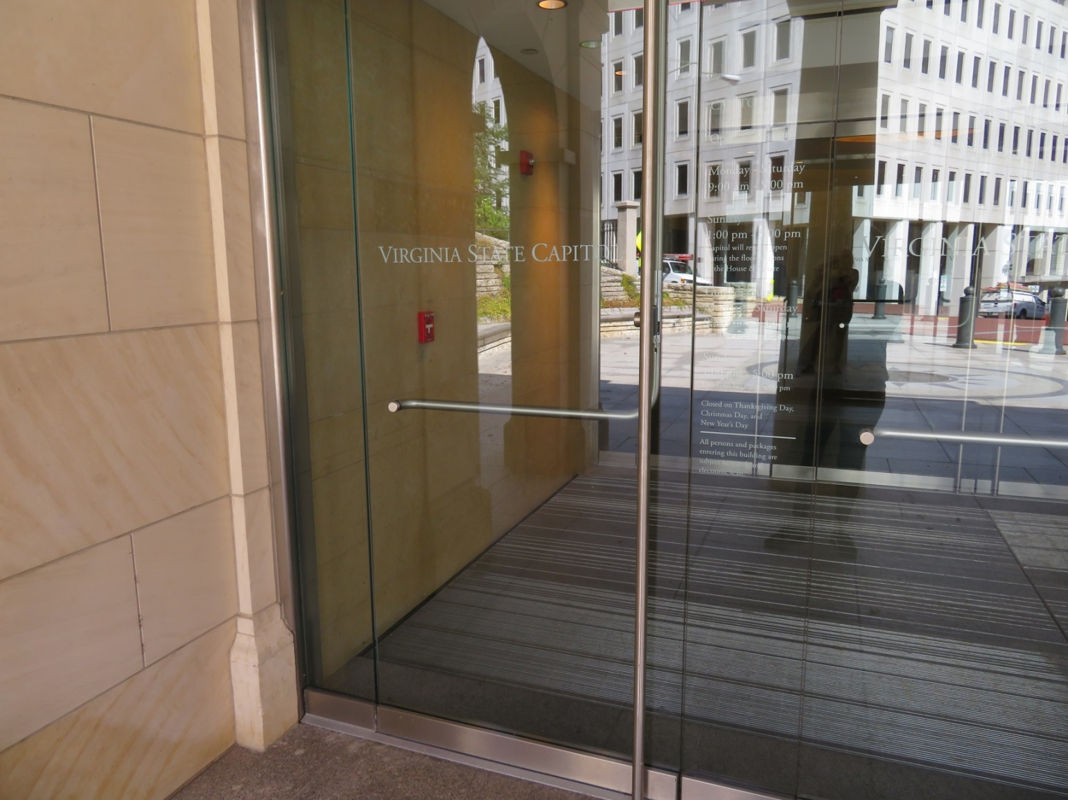
Modern and classy entrance.

Slide 8
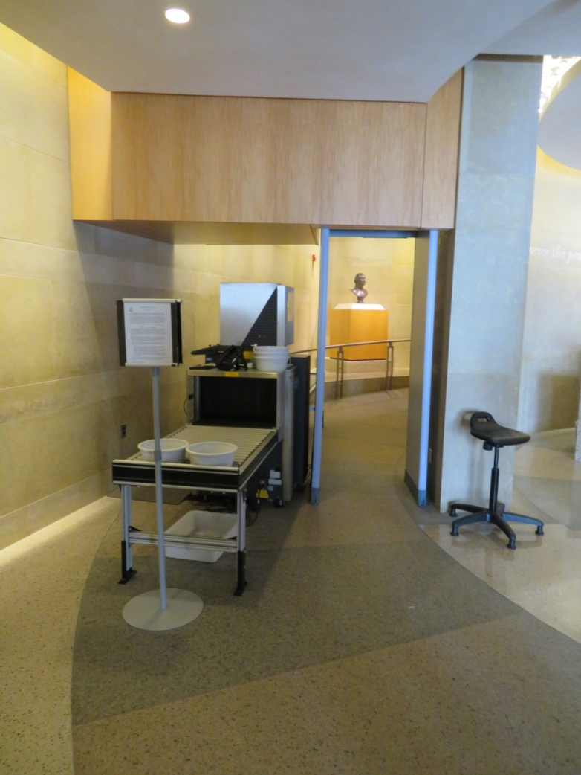
One magnetometer at the visitors center entrance is able to handle all of the foot traffic into the Capitol.

Slide 9
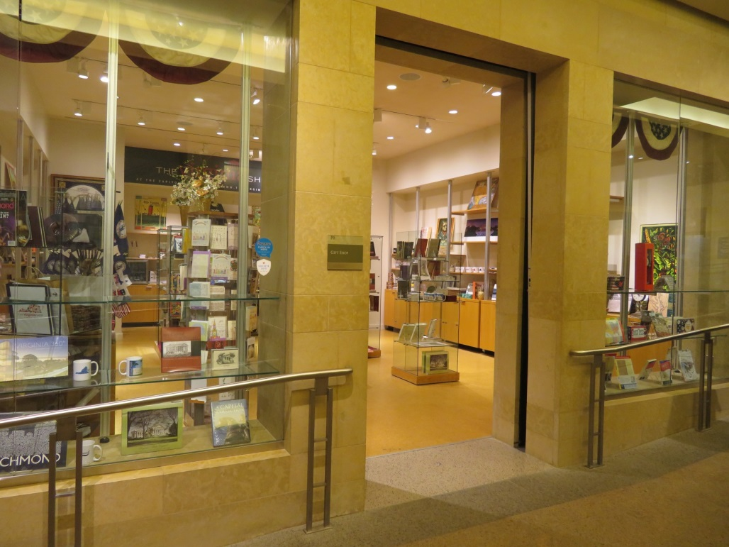
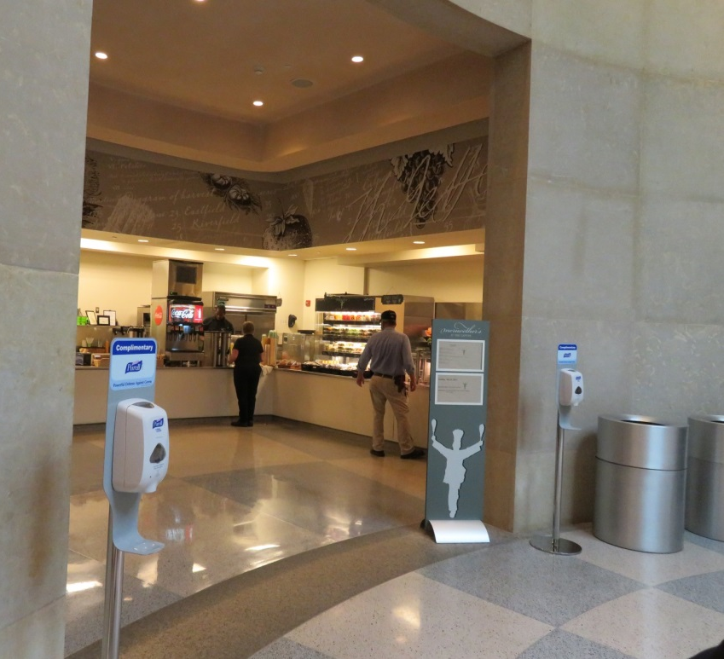
Very open and enticing gift shop and café give visitors additional ways to
spend time at the capitol.

Slide 10
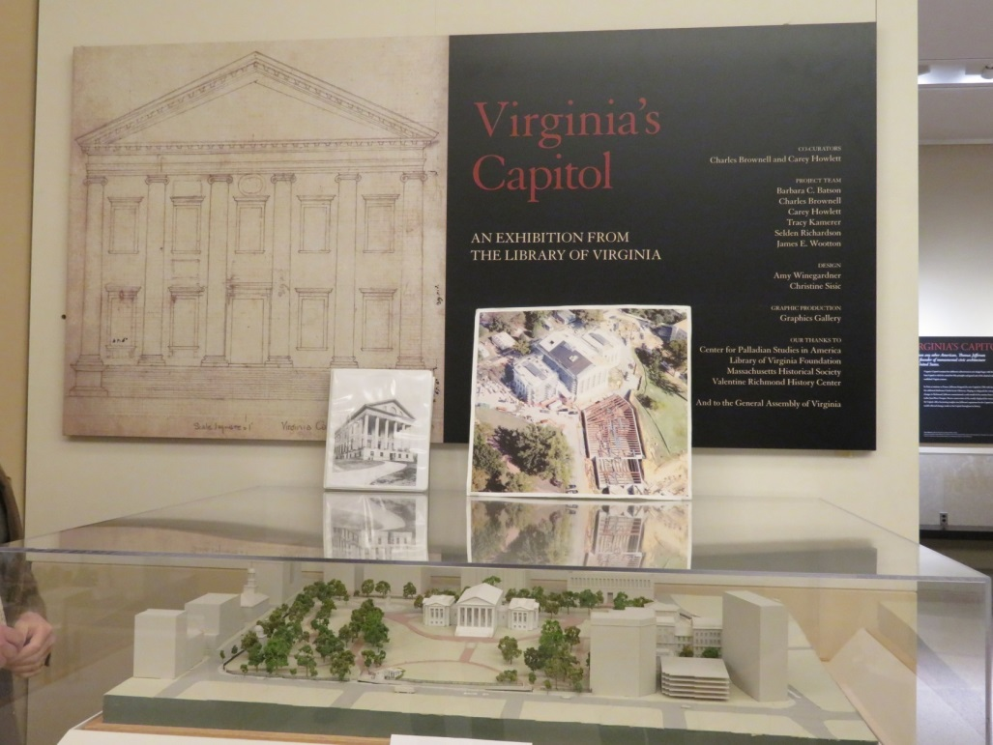
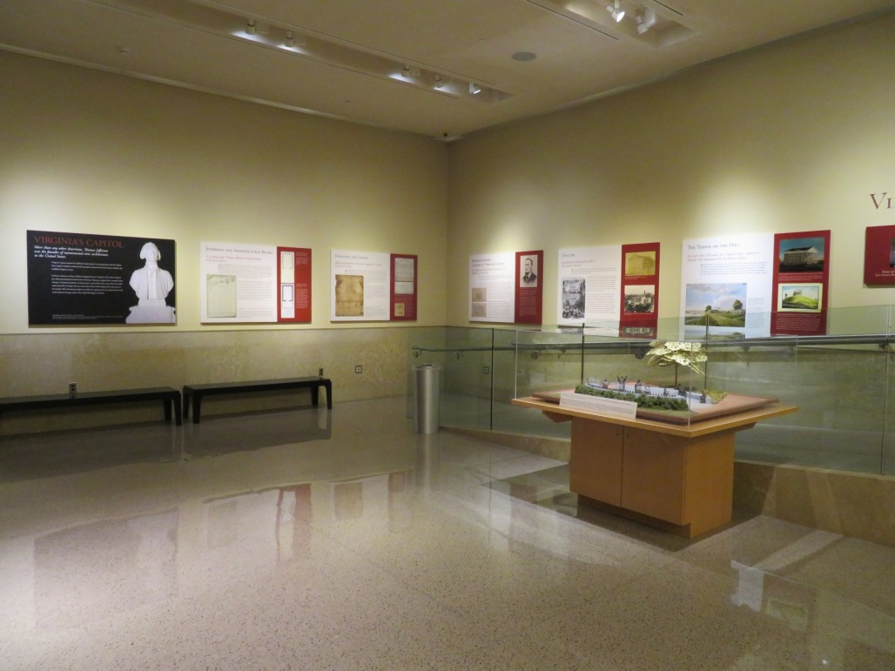
Almost every space of the visitor center is filled with historic information.

Slide 11
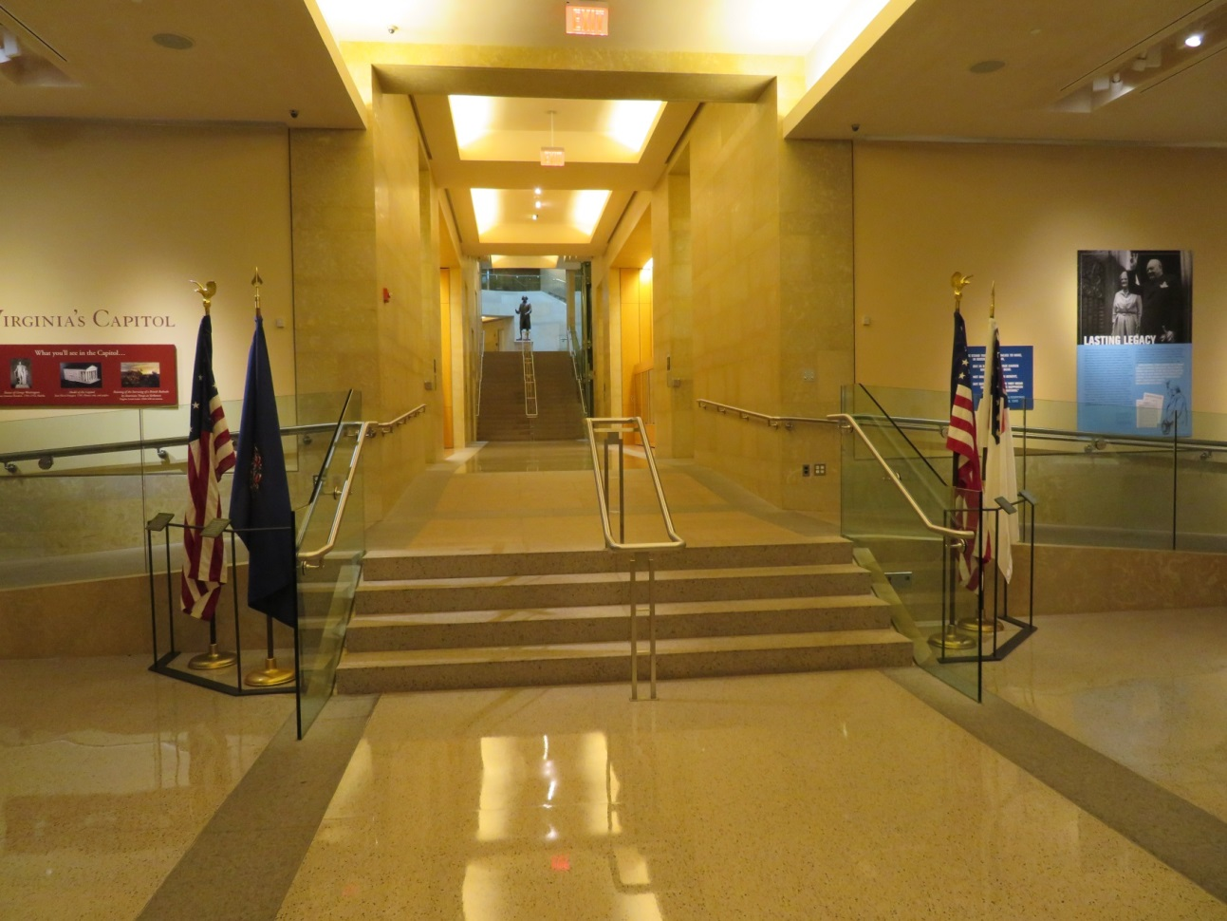
Dedicated areas for visitors end here and new underground space provides a route guiding foot traffic toward the historic building. The space to the left and right are multifunctional and used as meeting spaces that double as hearing rooms.

Slide 12
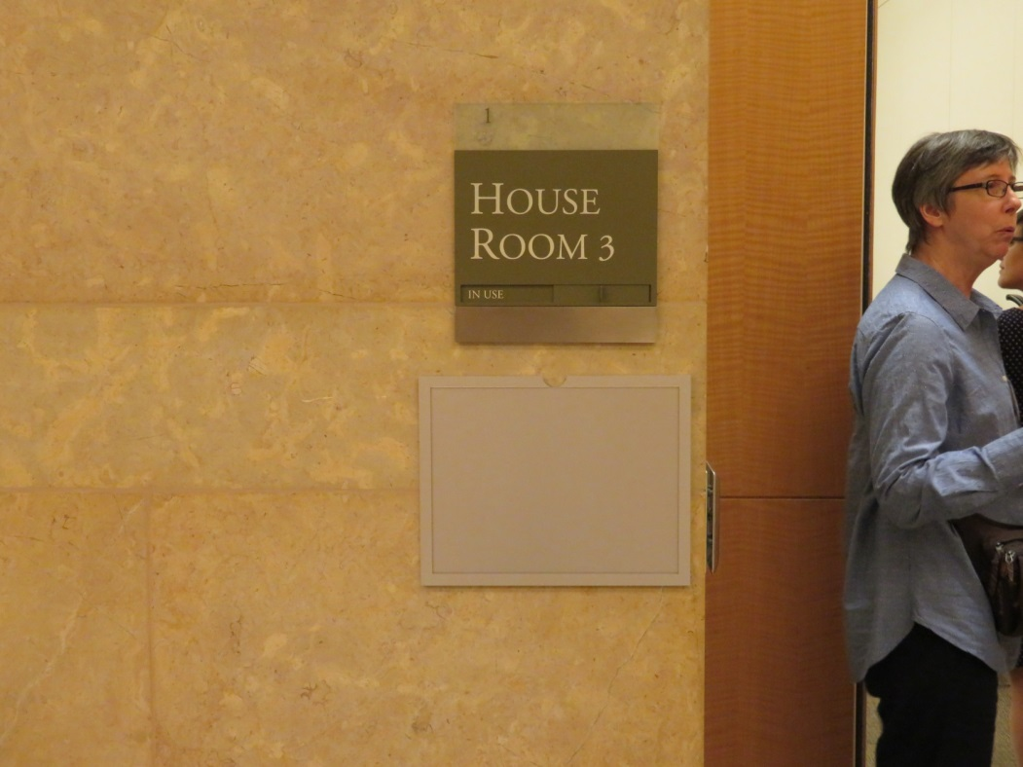
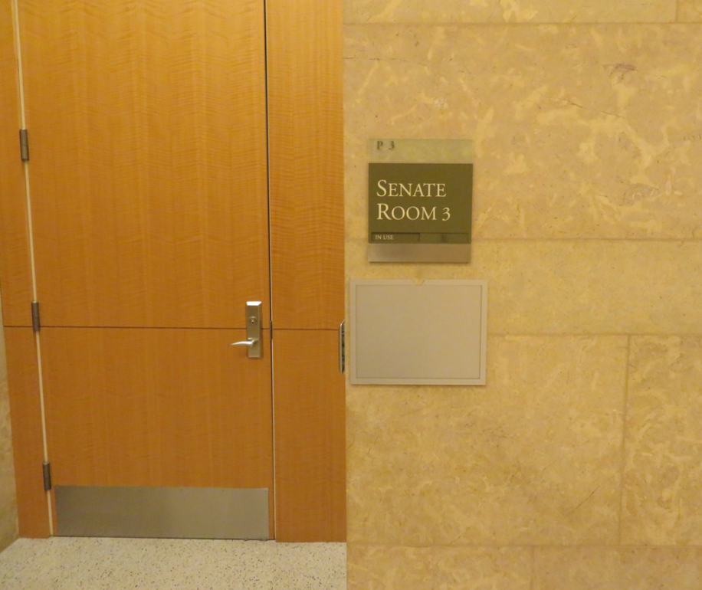
Rooms are designated by the two houses.

Slide 13
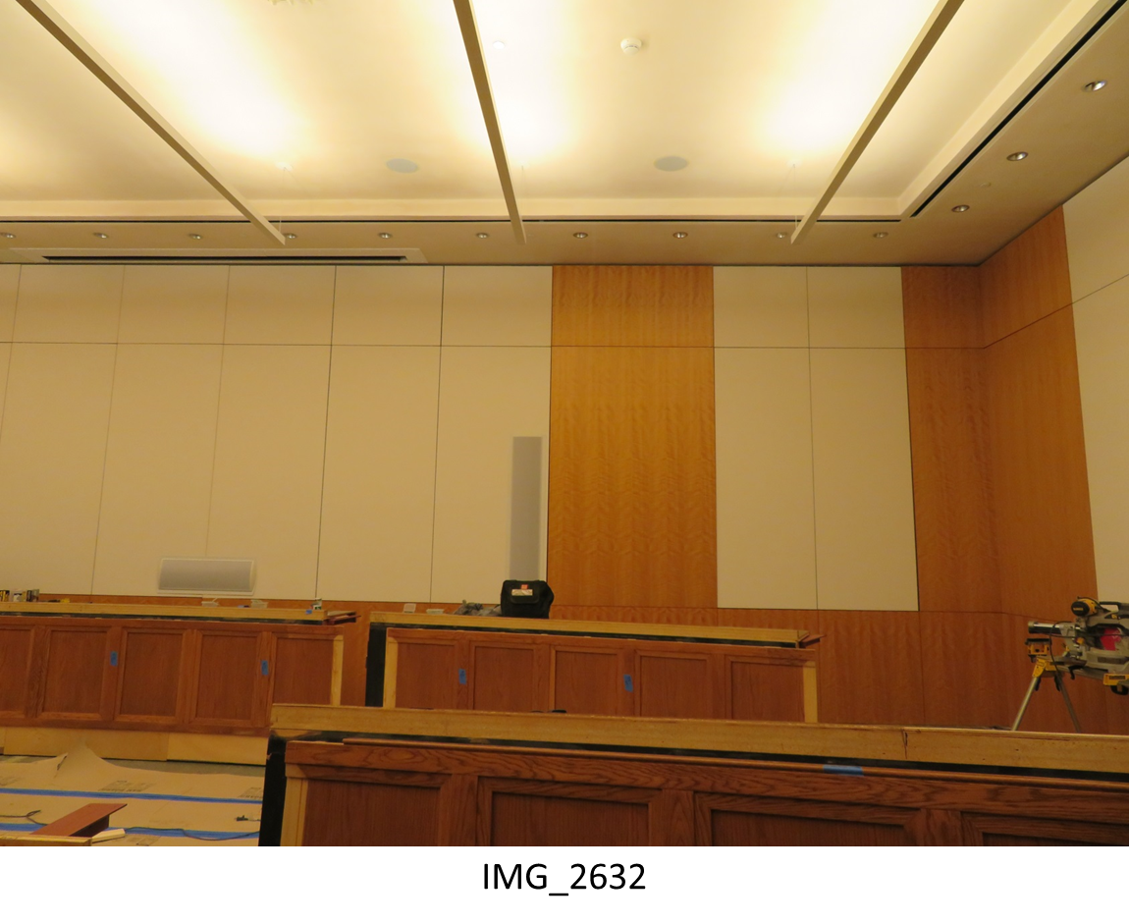
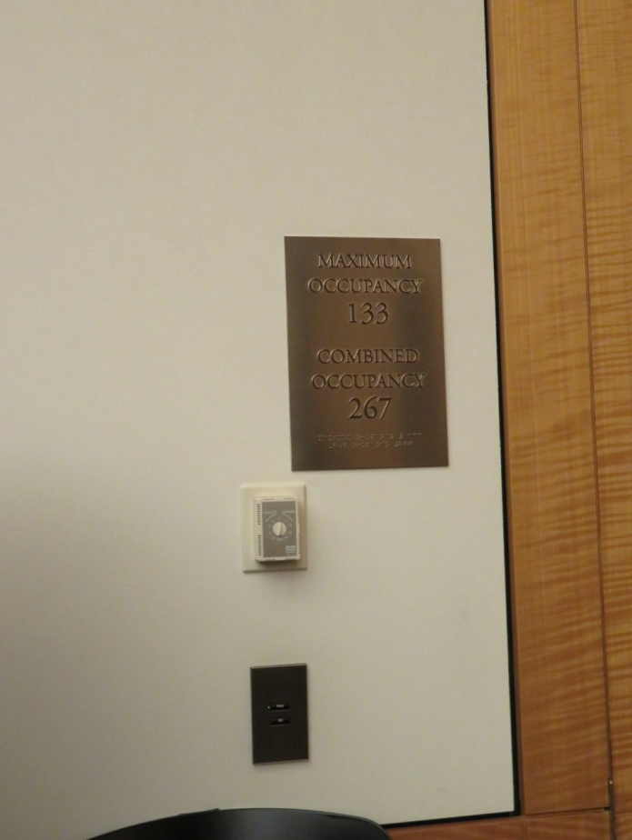
Multi-purpose meeting rooms are furnished as
modifiable hearing rooms for short term use.

Slide 14
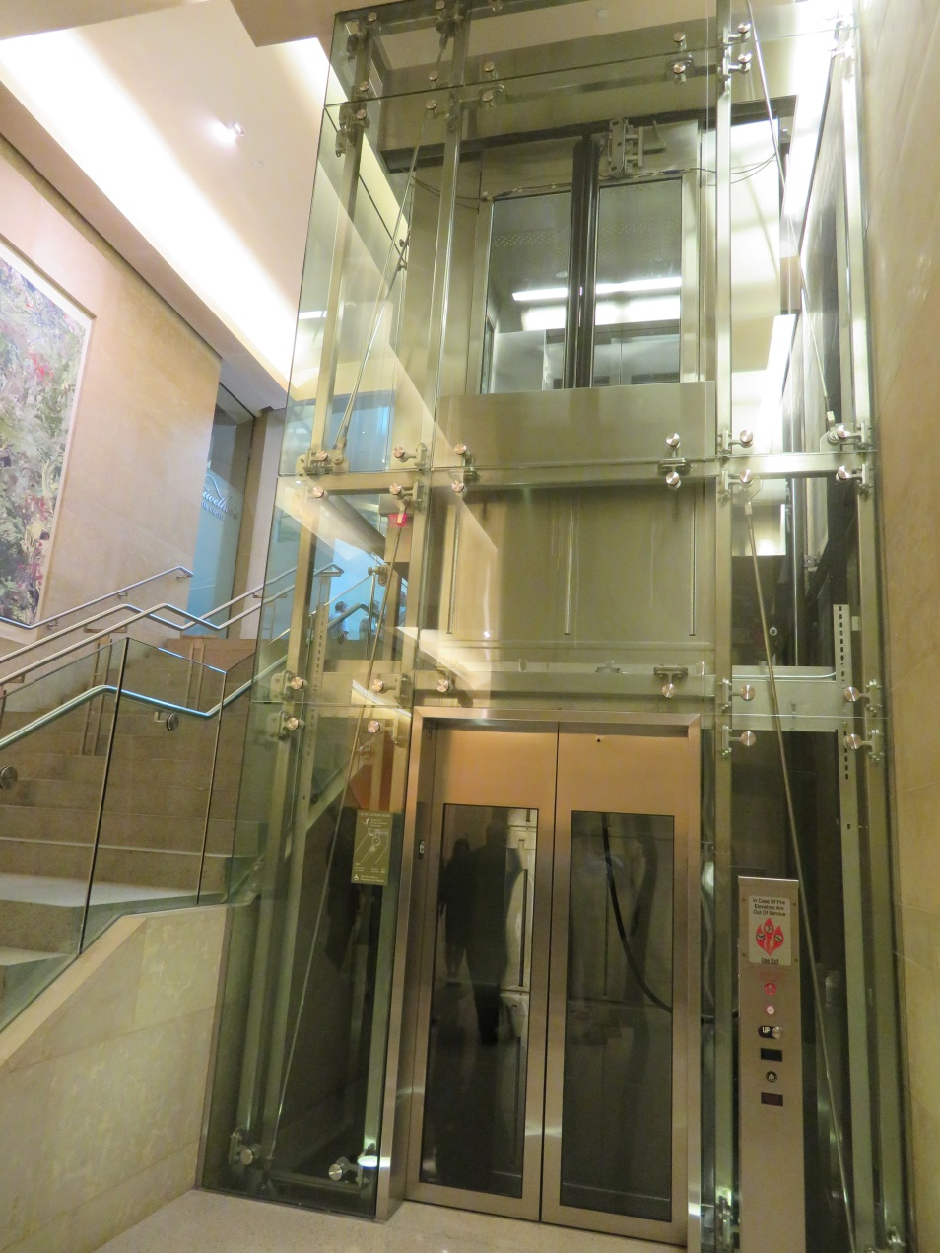
Gurney capable elevator.

Slide 15
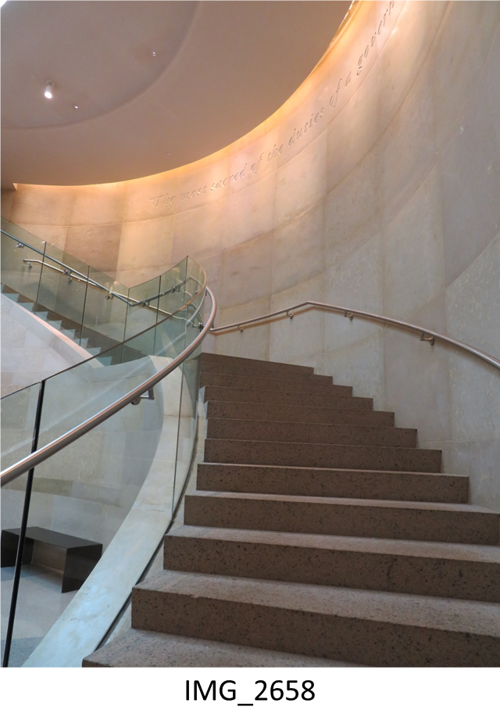
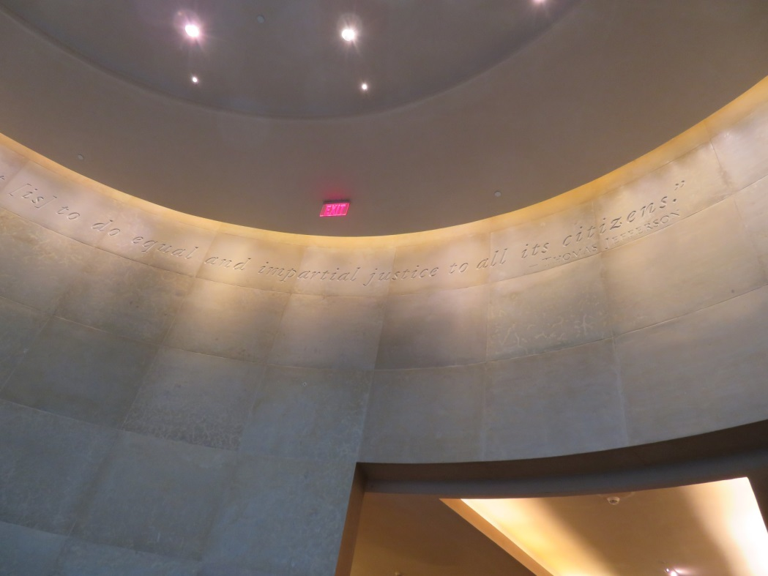
Elegant underground space provides transition to the historic capitol.

Slide 16
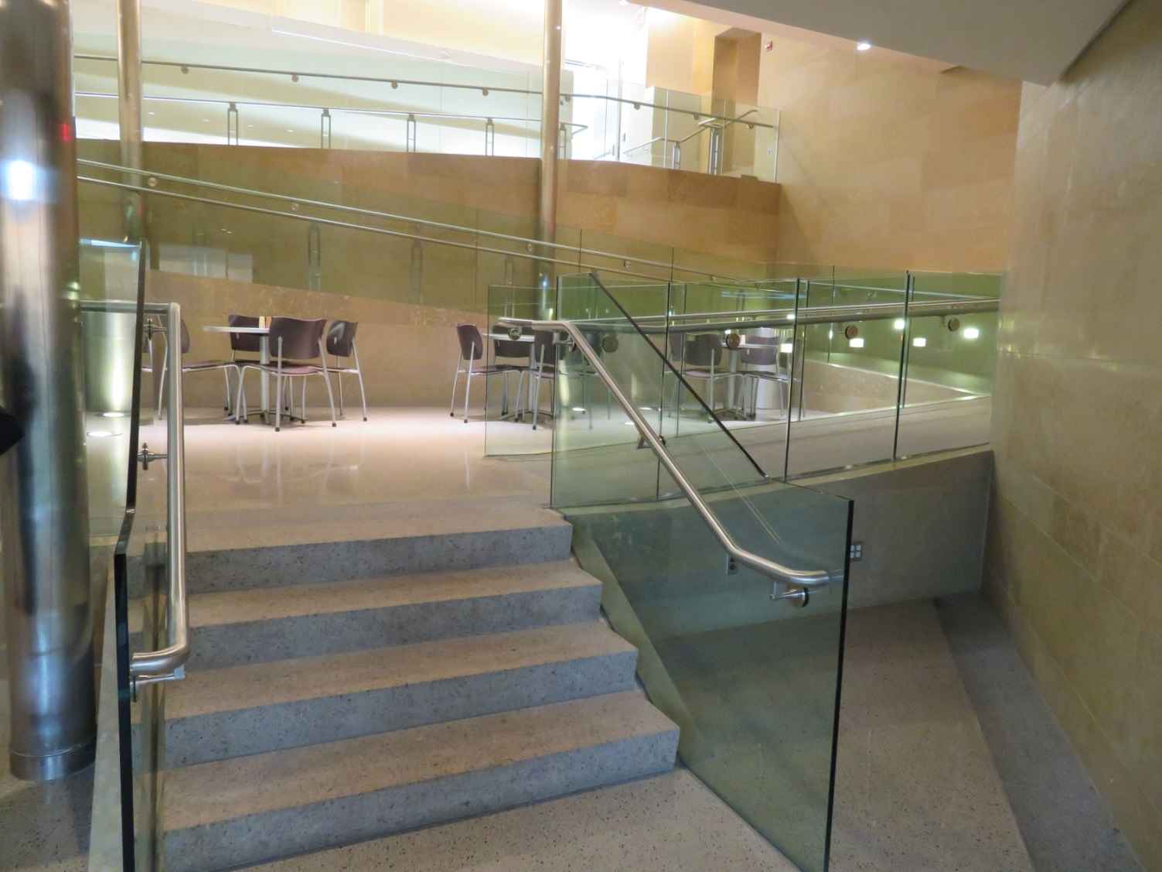
Pathway to the historic capitol is further utilized for impromptu seating areas.

Slide 17
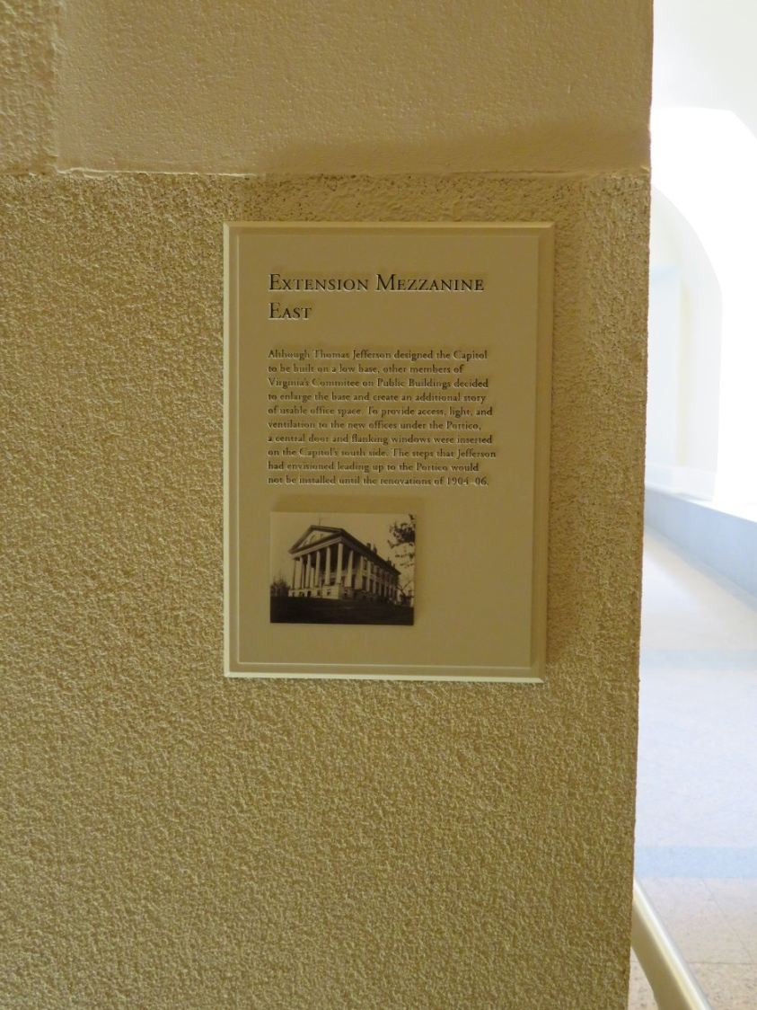
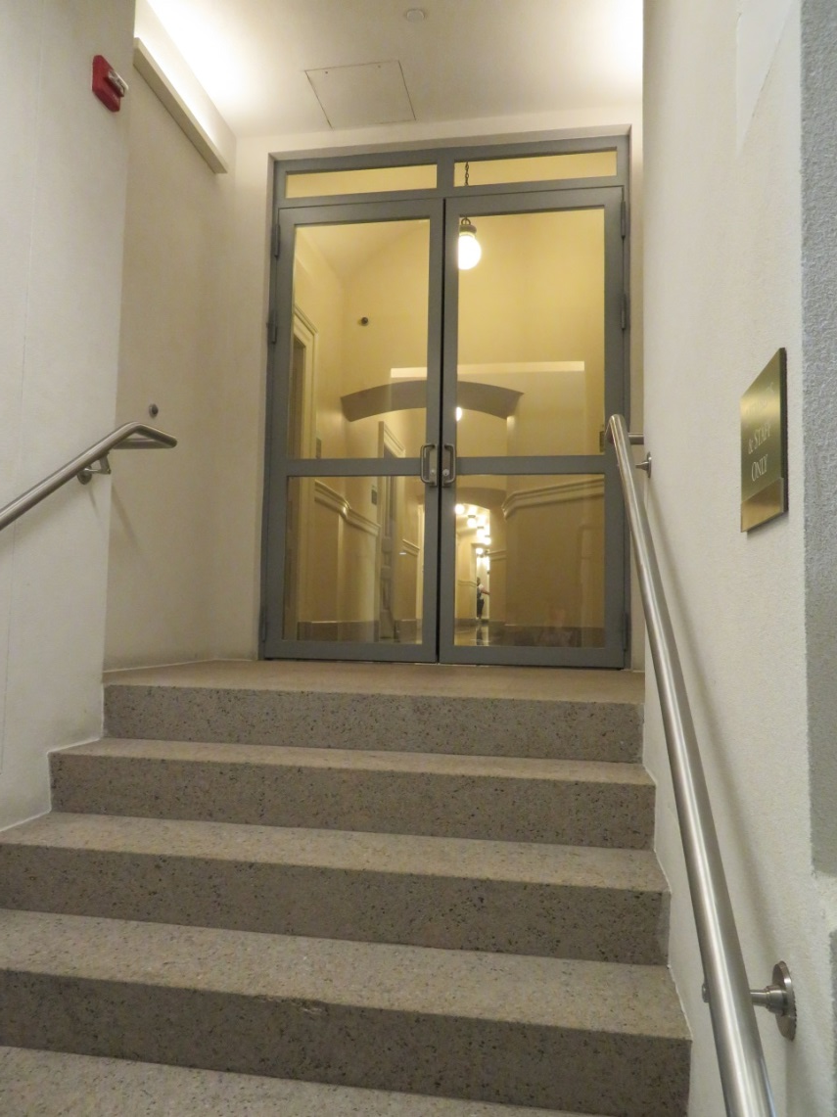
Once the end of the new visitors center footprint is reached, visitors pass the threshold into the historic capitol without going through security again.

Slide 18
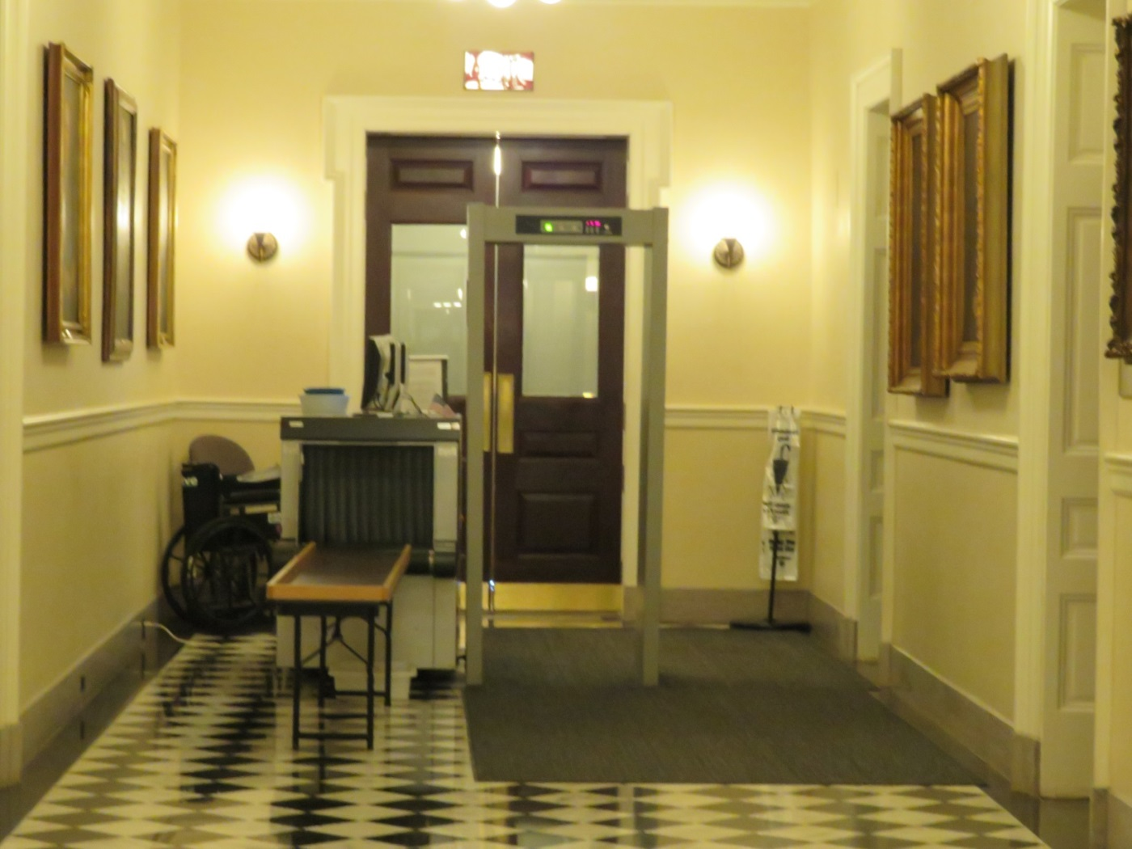
Entrances to the historic capitol are located above ground for people entering directly into the capitol.

Slide 19
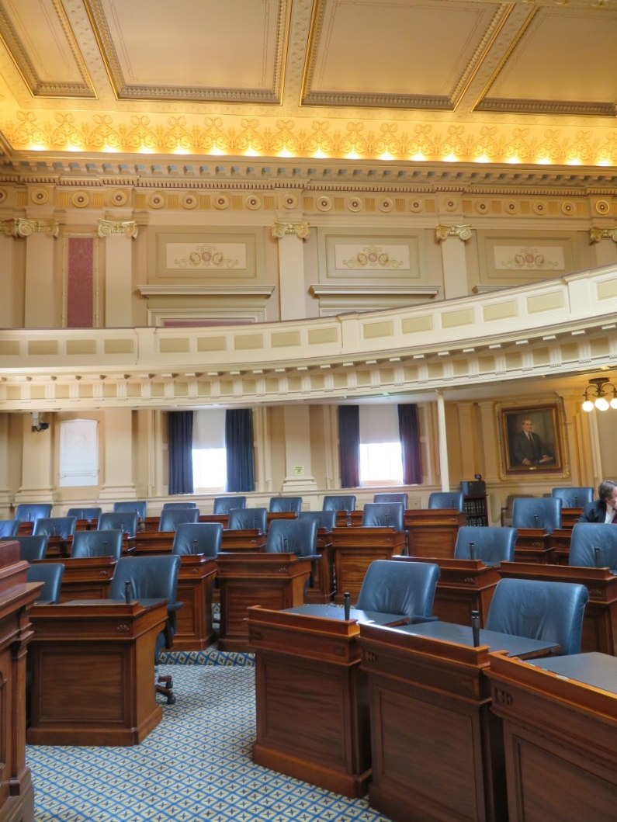
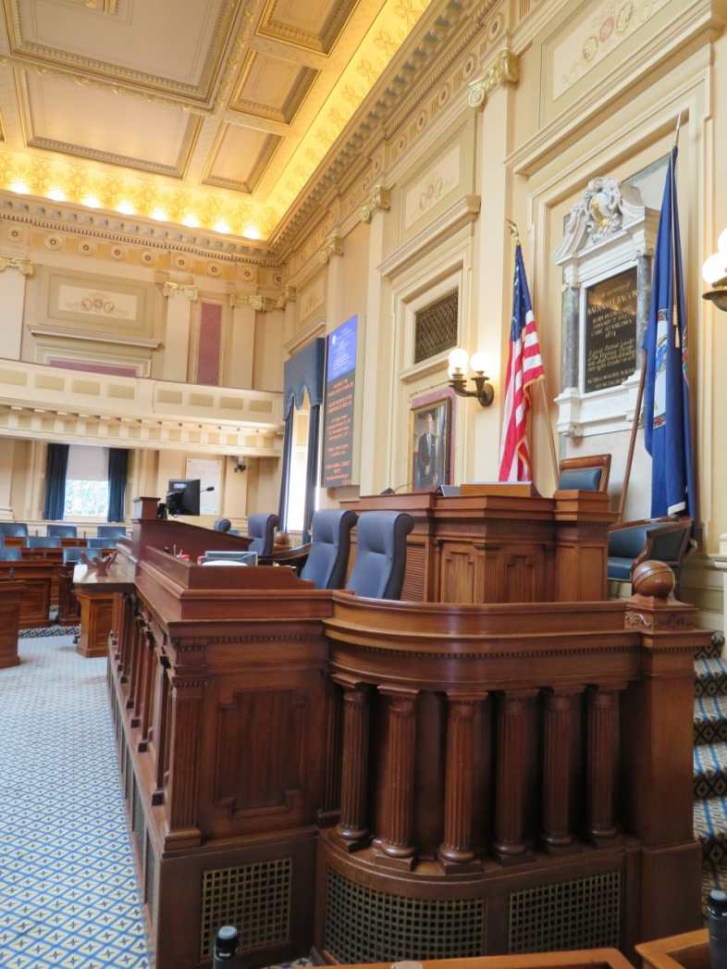
Restored House Chambers

Slide 20
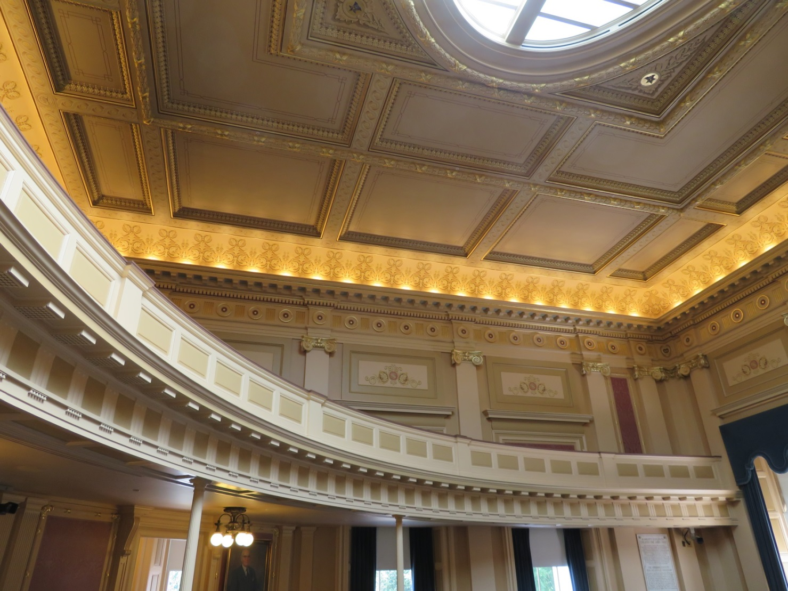

Slide 21
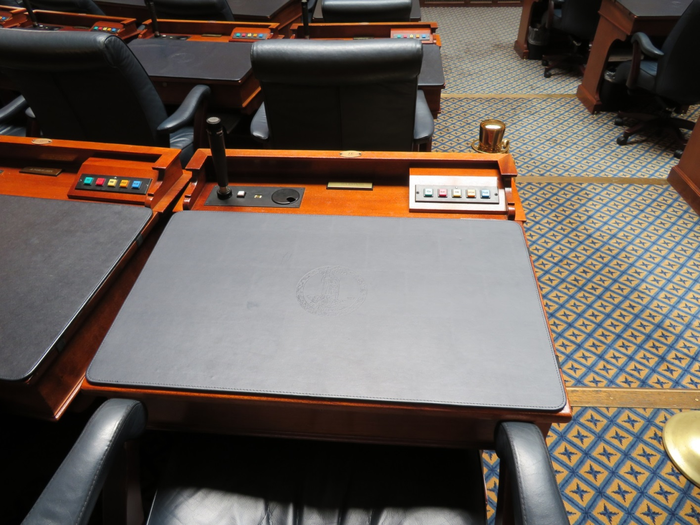
Custom pads on each legislator’s desk allows a lot of flexibility of use in the chambers and less stress about the importance of preserving the furniture.

Slide 22
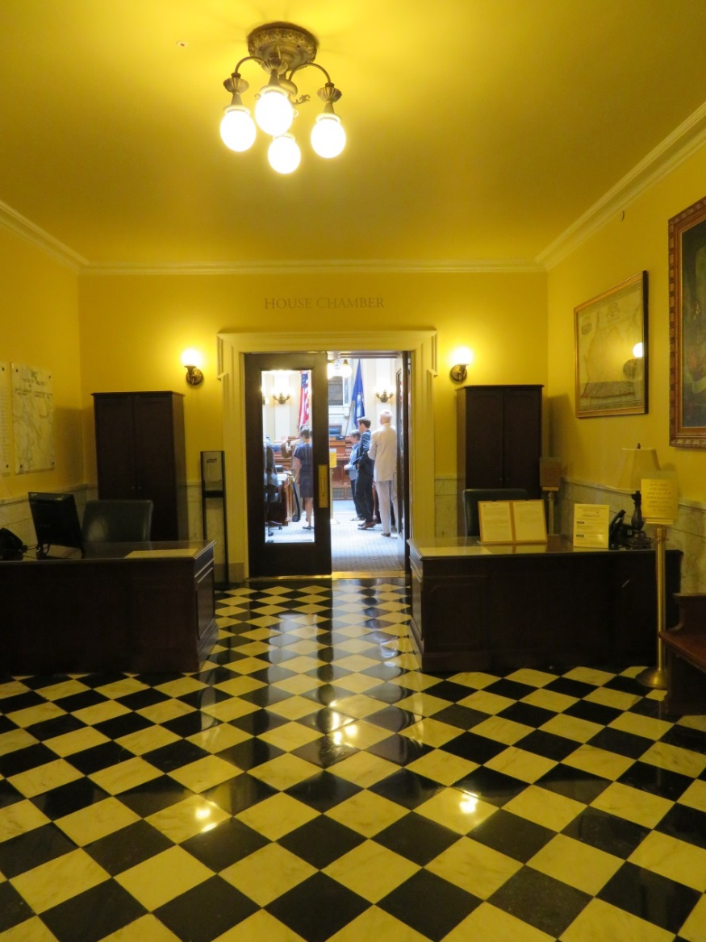
Reception area at the front of the House Chambers regulates the accessible floor.

Slide 23
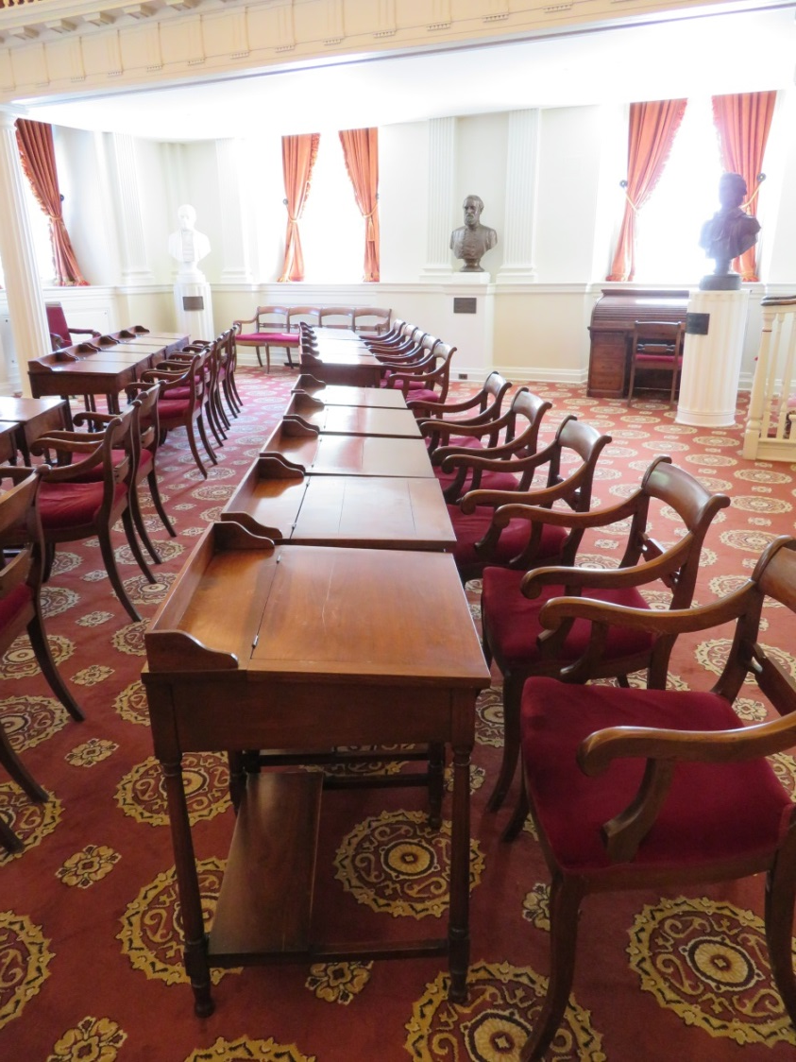
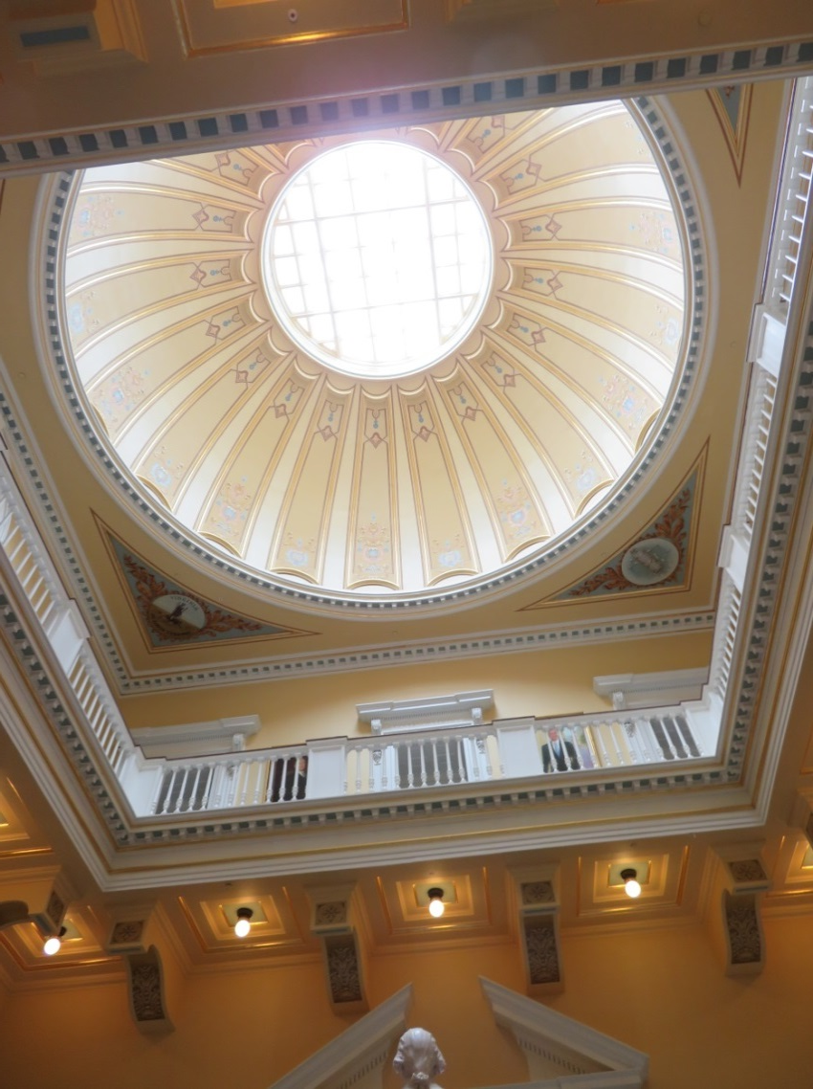
The Historic House Chambers was preserved as a museum space.

Slide 24
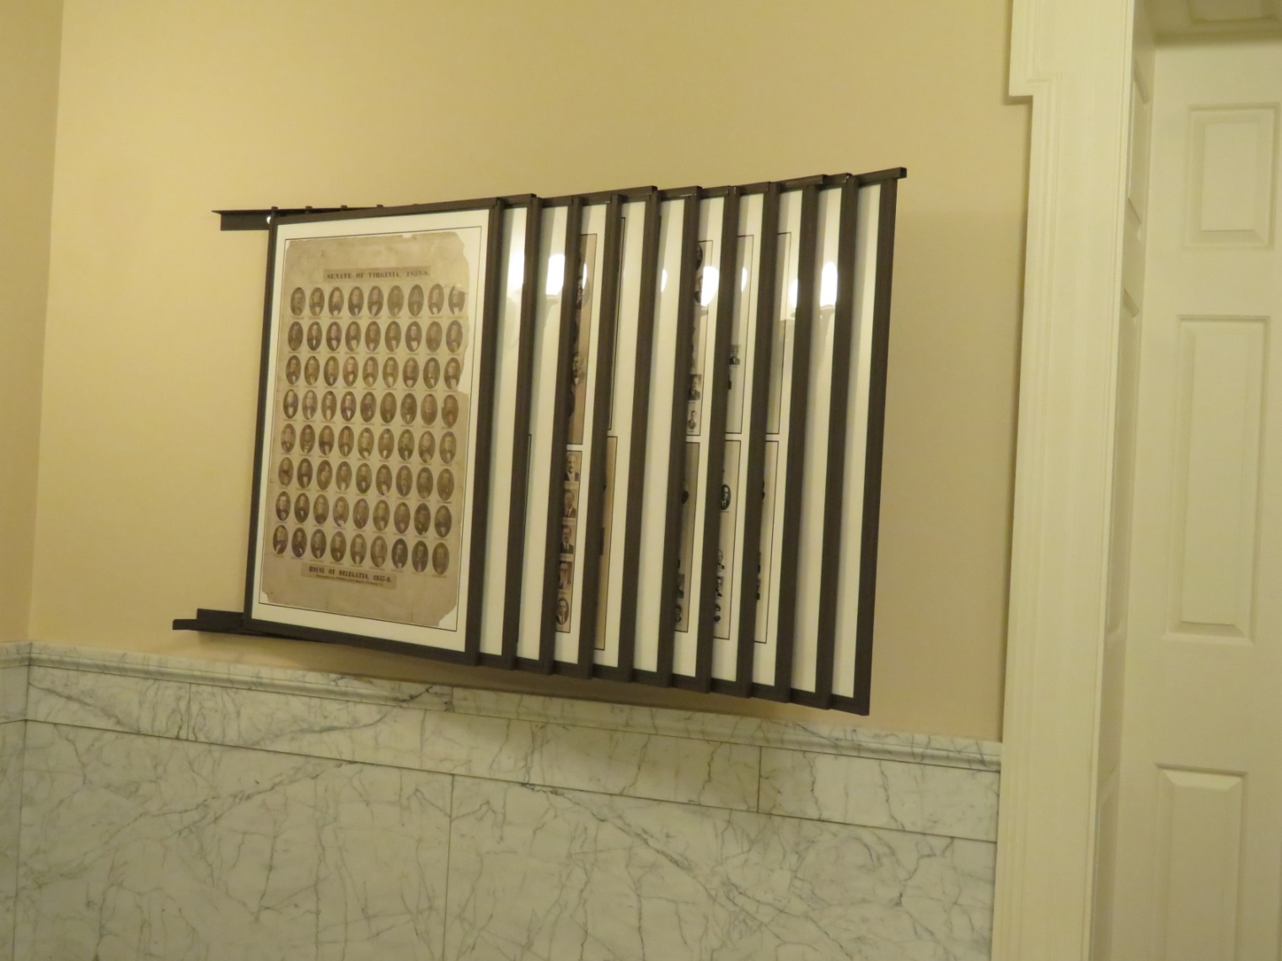
Engaging displays and signage are located throughout the historic building.

Slide 25
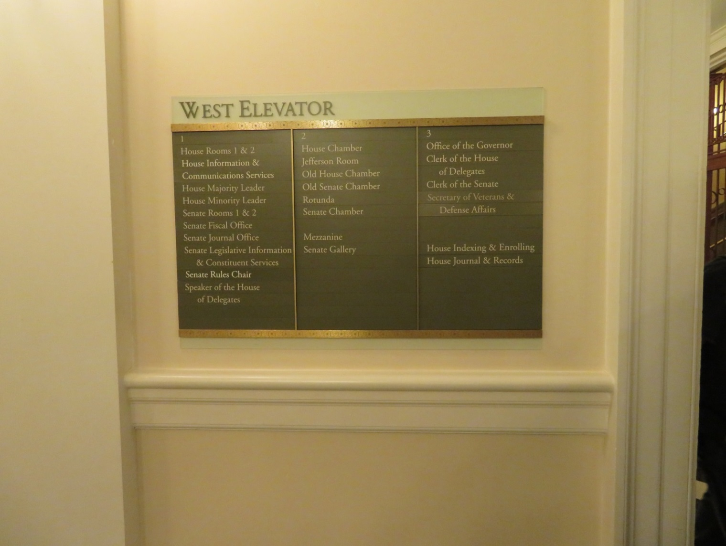

Slide 26
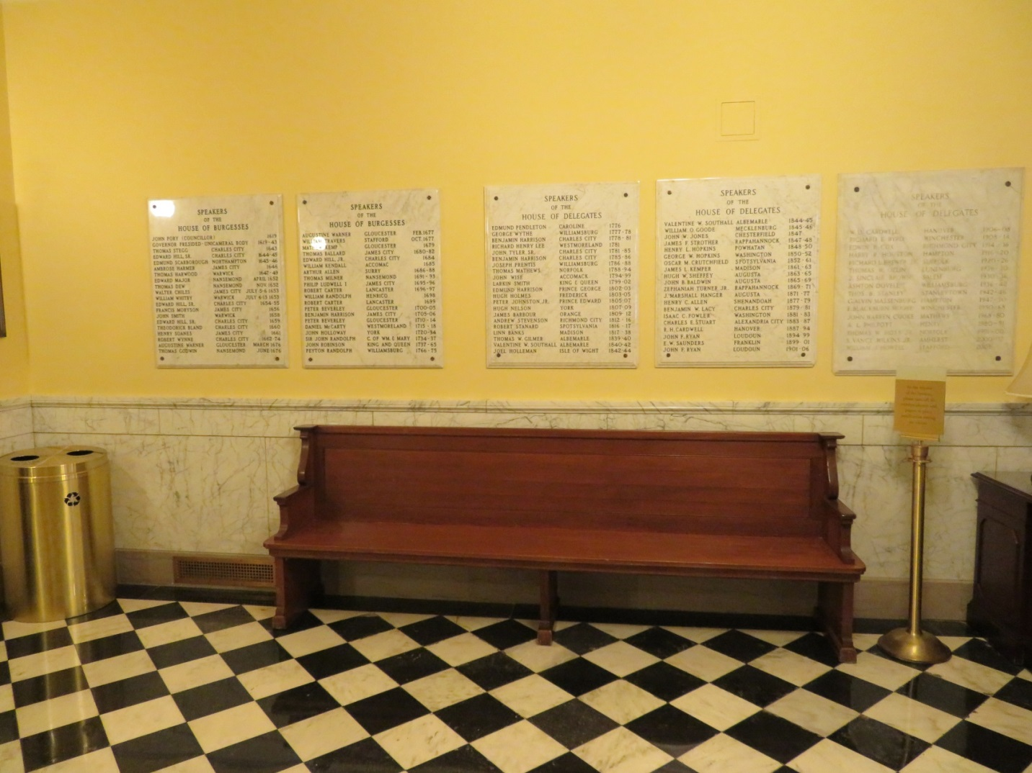
Beautiful plaques to preserve the history
of leadership of the two legislative houses.

Slide 27
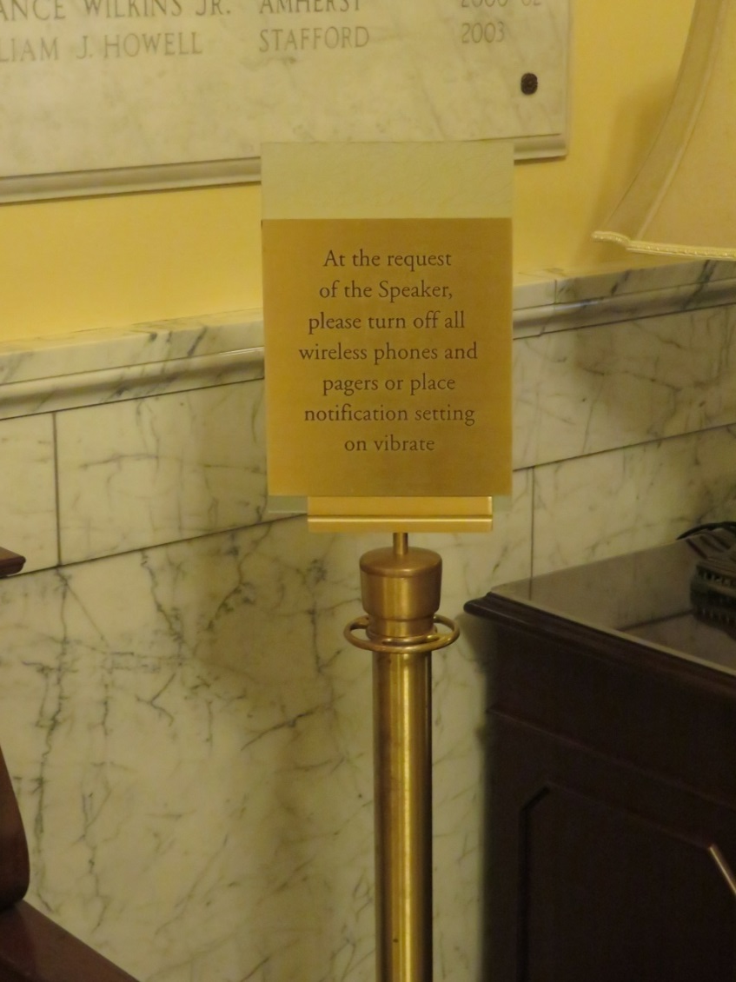
Elegant signage invites appropriate behavior and respect for the work being done at the Capitol.

Slide 28
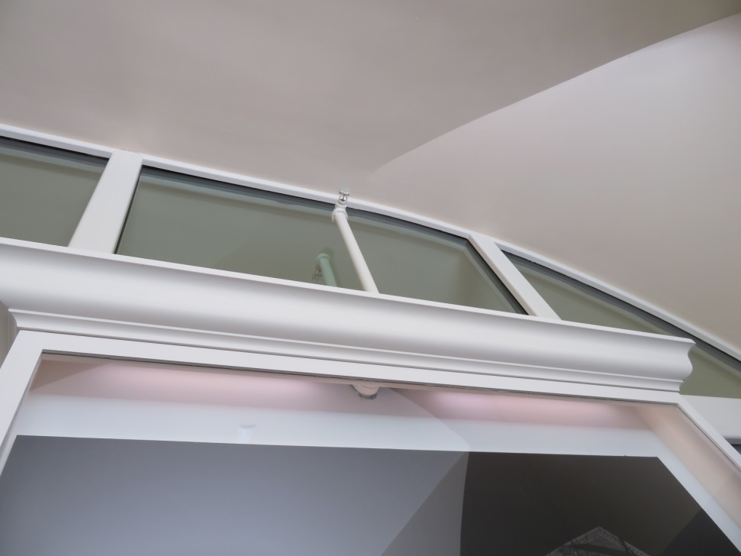
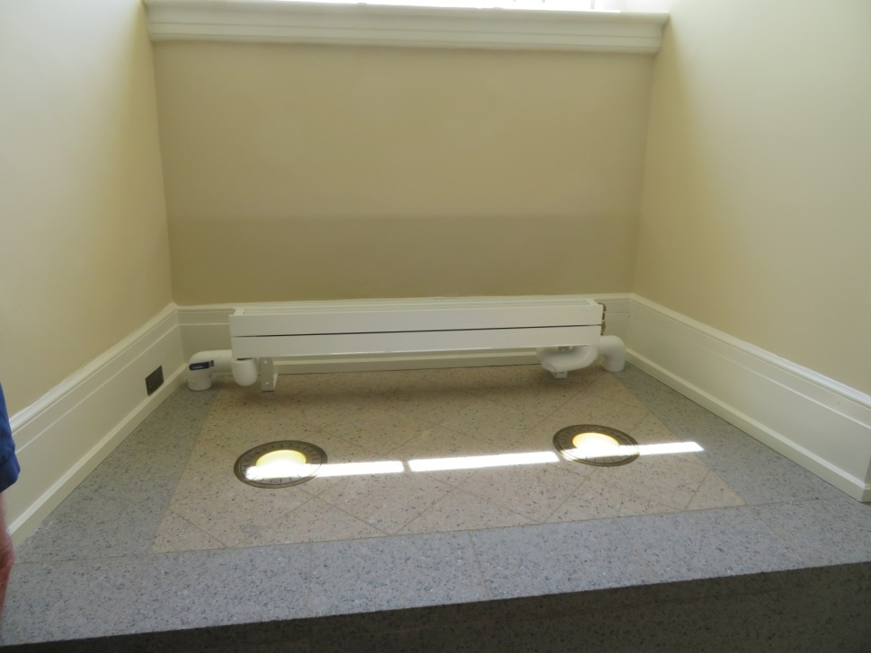
Award winning design integration of emergency response systems.

Slide 29
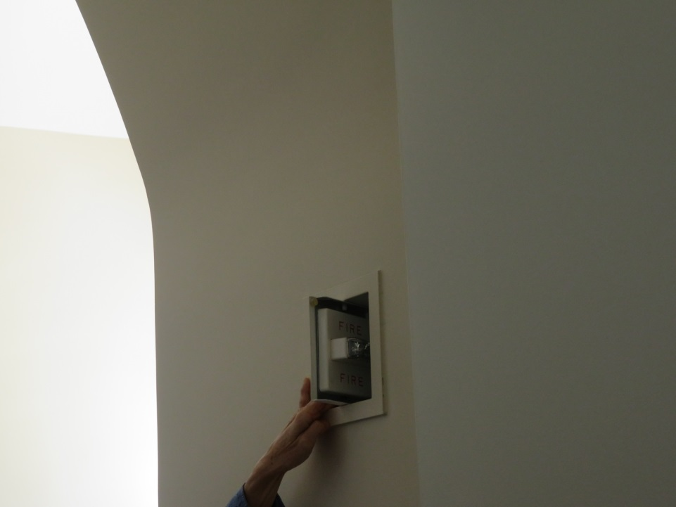
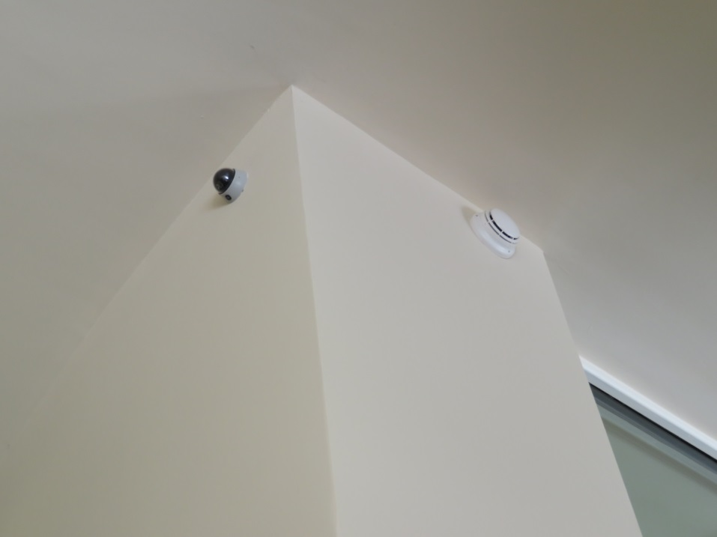

Slide 30
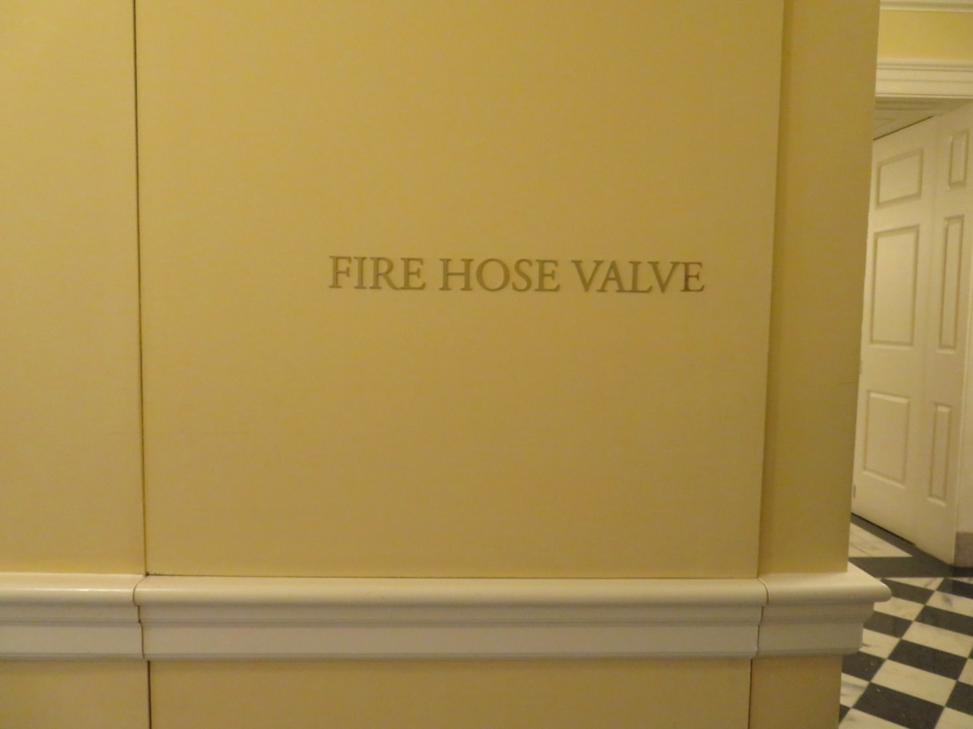
Life safety equipment is stored in a way that protects the public and the historic look of this important building.

Slide 31
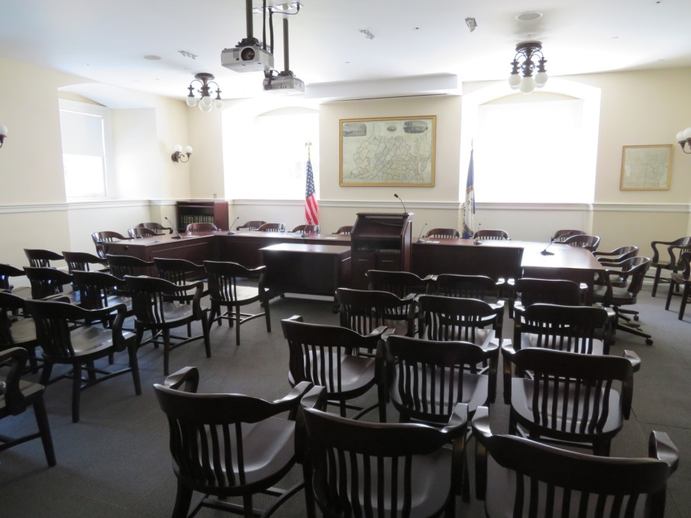
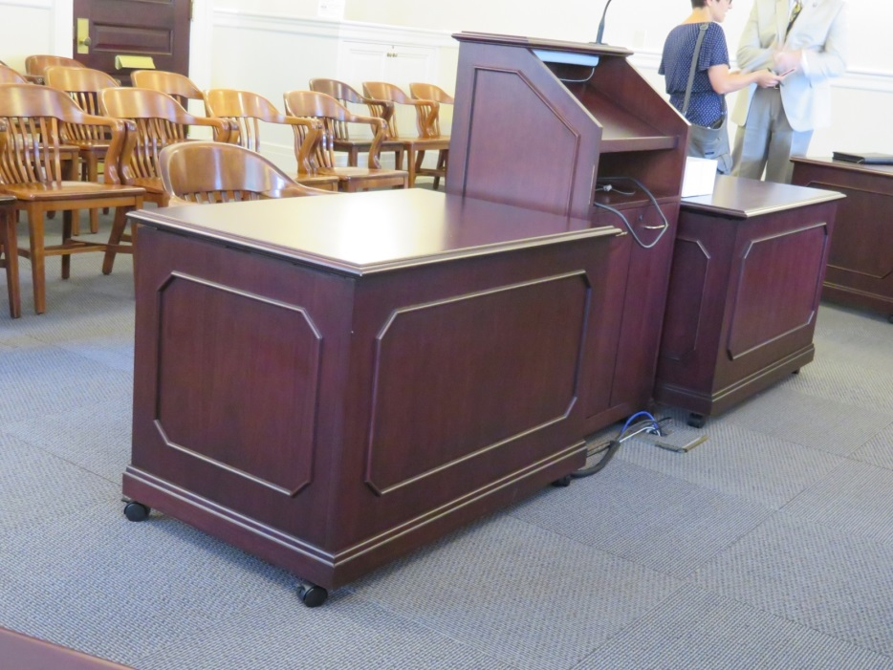
Committee hearing rooms have a completely mobile format.

